Slide 1
Text Analysis with Supervised Machine Learning
Day 2

Slide 2
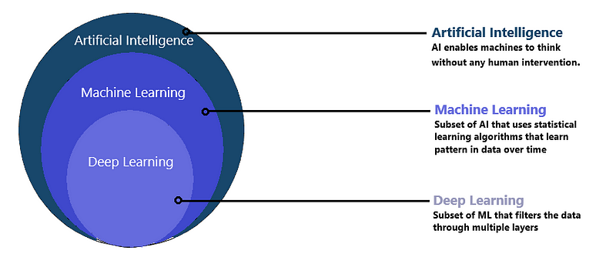
What is Machine Learning?

Slide 3

What is Machine Learning?
Rule-based system
Expert-driven system
If-then rules to make decisions and perform tasks
Give loan if income >50,000
credit card fraud if geographic anomaly
anomaly-based detection rules in cyber security
signature-based detection rules in cyber security
Downside: new threats, fraud tactics etc.
Machine learning
Automatically learn and improve from experience without being explicitly programmed
Data-driven approach
Downside: lack of data- simulation data scientist

Slide 4
Types of Machine Learning
Supervised Learning
Unsupervised Learning
Semi-Supervised and Transfer Learning
Reinforcement Learning

Slide 5
Supervised Learning Intuition
Var1 | Var2 | Var3 | Var4 | Var5 | Var6 | Var7 | Var8 | Var9 | class
94.99 | 105.35 | 10.56 | 10.45 | 105.46 | 106.34 | 107.39 | 109.22 | 101.22 | 1
9.55 | 10.35 | 100.56 | 100.45 | 10.55 | 55.49 | 10.21 | 10.44 | 10.25 | 0
9.77 | 10.35 | 100.56 | 100.45 | 10.46 | 10.34 | 10.39 | 10.22 | 10.22 | 0
94.96 | 105.35 | 10.56 | 10.45 | 105.46 | 106.34 | 107.39 | 109.22 | 101.22 | 1
94.98 | 105.35 | 10.56 | 10.45 | 105.46 | 106.34 | 107.39 | 109.22 | 101.22 | 1
9.90 | 10.35 | 103.56 | 104.45 | 10.46 | 10.34 | 10.39 | 10.22 | 10.22 | 0
94.99 | 105.35 | 10.56 | 10.45 | 105.46 | 106.34 | 107.39 | 109.22 | 101.22 | 1
Var1 | Var2 | Var3 | Var4 | Var5 | Var6 | Var7 | Var8 | Var9 | class
99.90 | 106.50 | 9.88 | 10.43 | 102.42 | 107.35 | 109.55 | 107.47 | 109.22 | ??
8.55 | 10.39 | 101.50 | 102.52 | 11.57 | 53.96 | 12.45 | 9.42 | 14.01 | ??

Slide 6
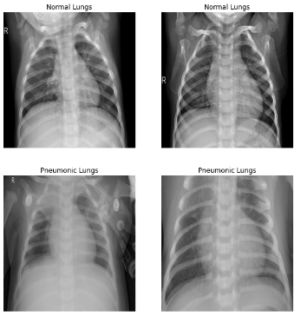
Normal
Which of these X-Ray Scans are Images of Pneumonia?
Pneumonia

Slide 7
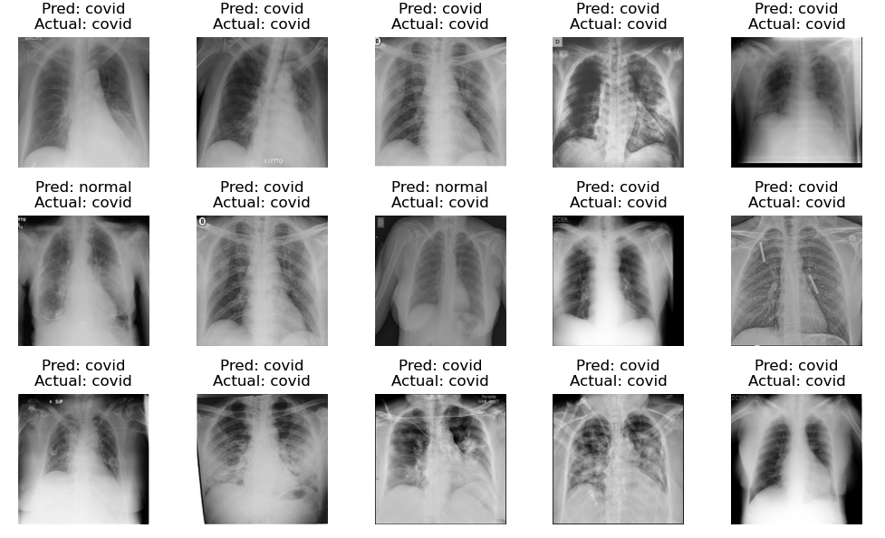

Slide 8
Supervised ML Tasks
Regression
Predicts a continuous outcome. For instance: house price predicted by number of bedrooms, area, location
Classification
Assigns a label from a predefined set to an instance. For instance: is an email spam or ham(not spam).
Computer vision
Associating images with labels. For instance: is an image a cat, dog, or a bird.
Speech Recognition
Translating spoken language into text or executing voice commands.

Slide 9
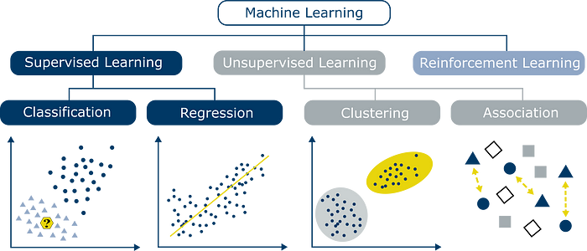

Slide 10
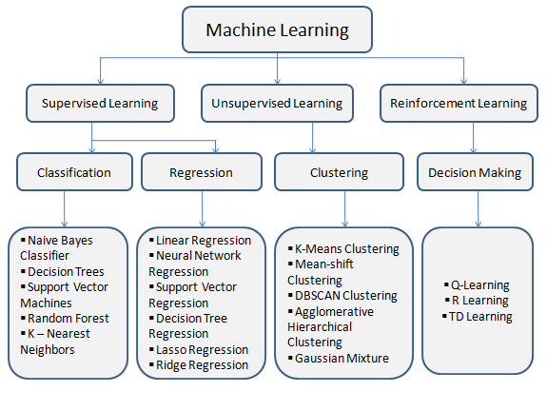
Algorithms Based on Types of ML

Slide 11
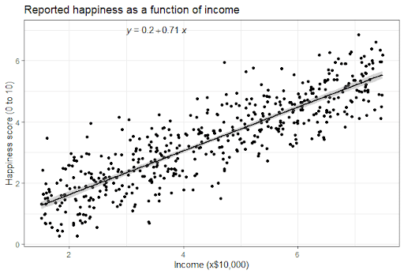
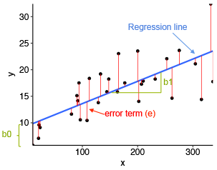
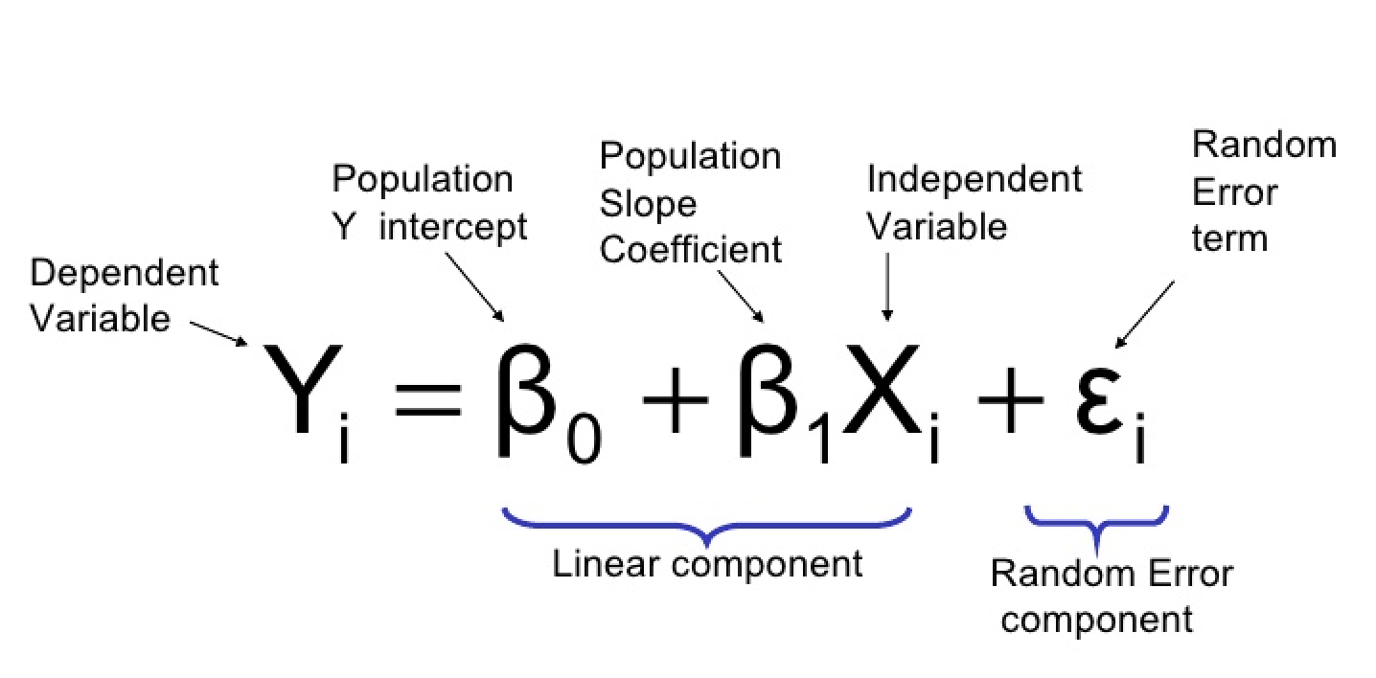
Simple Linear Regression

Slide 12
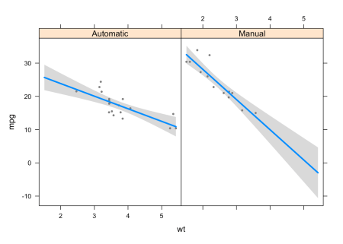
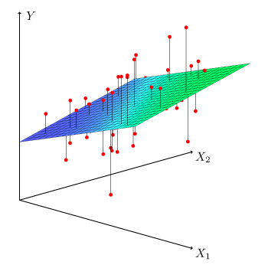
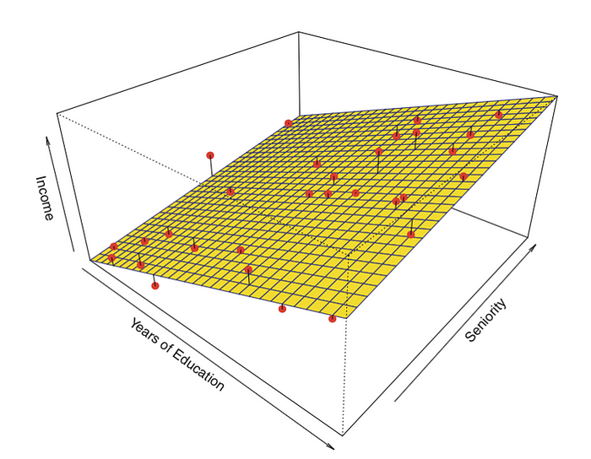
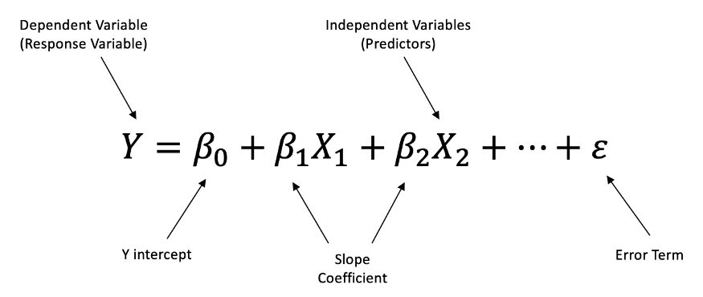
Multiple Linear Regression

Slide 13
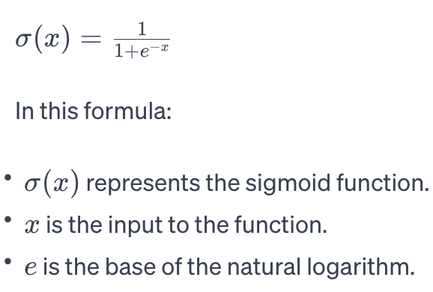
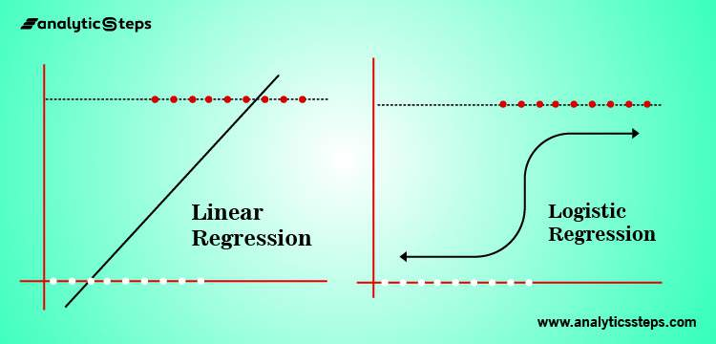
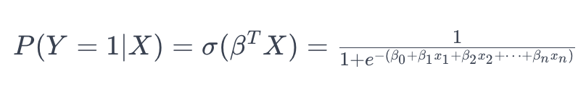
Logistic Regression Classifier

Slide 14
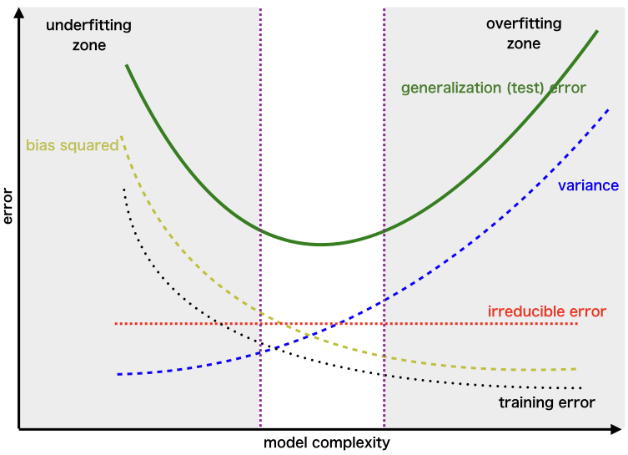
Fundamental Problem in Machine Learning: Trade Off Between Bias and Variance Document feature Matrix ➔ Adding Too Many Variables Cause Overfitting

Slide 15
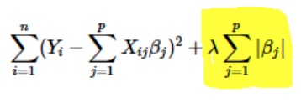
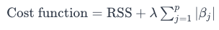
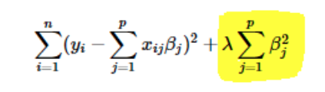
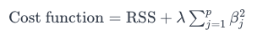
Regularization is One Solution to Overfitting!
LASSO Regression
Ridge Regression
Elastic Net

Slide 16
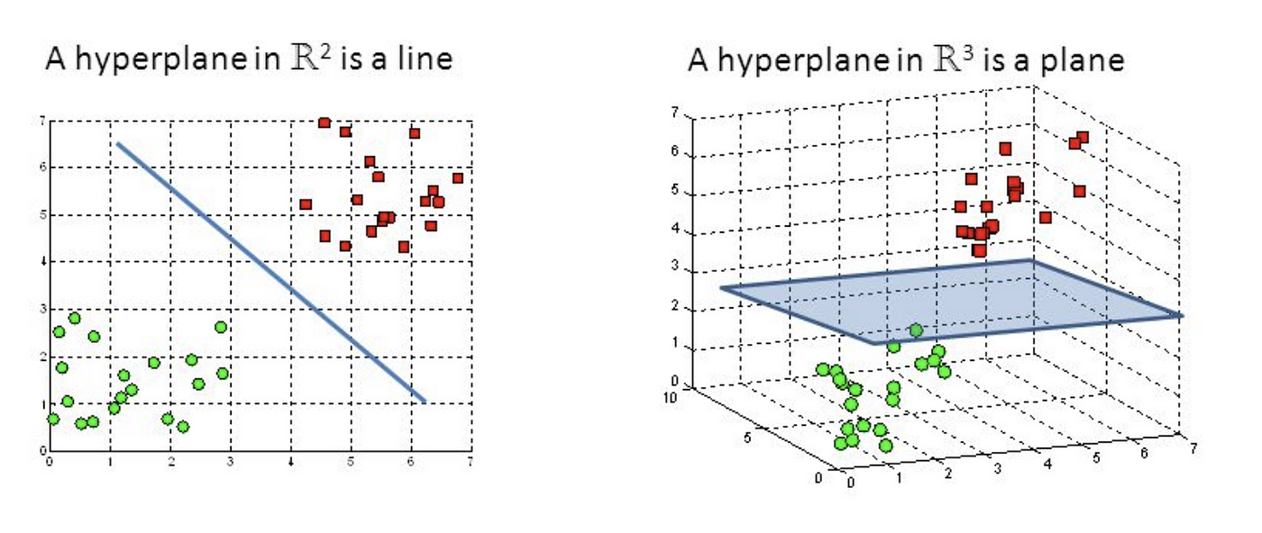
Support Vector Machines(SVM)

Slide 17
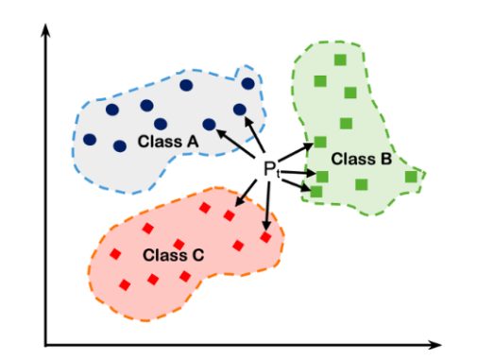
K-Nearest Neighbors (KNN)

Slide 18
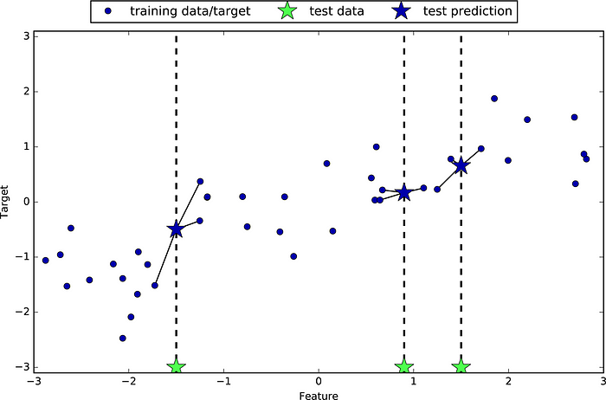
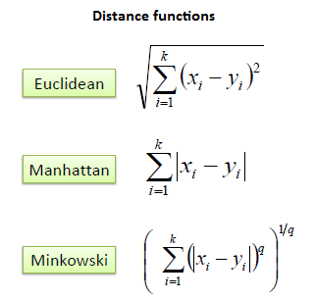
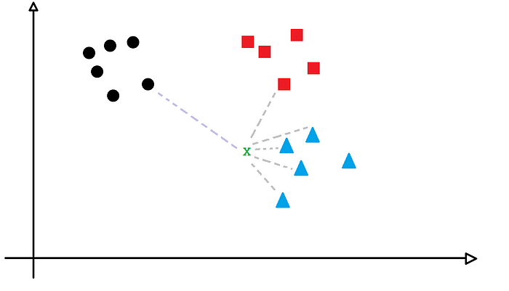
KNN Regression

Slide 19
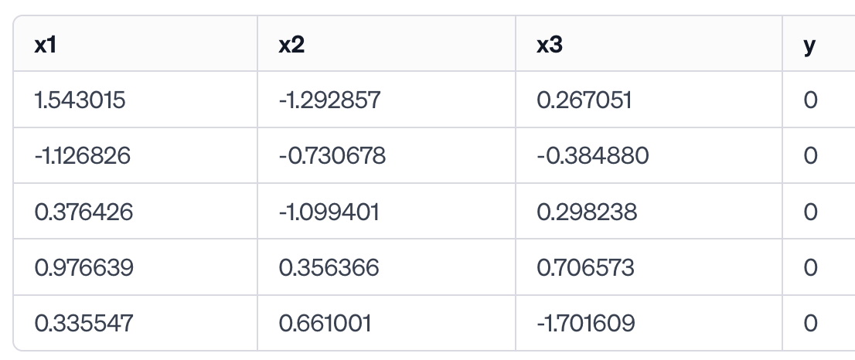
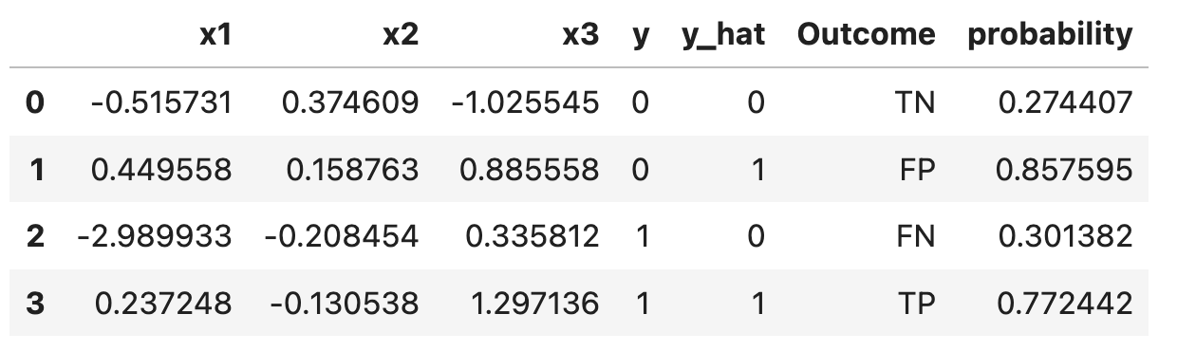
Model Evaluation on Test Data
Train Data
Condition Positive (P): number of real positive cases in data.
Condition Negative (N): number of real negative cases in the data.
True Positive (TP): A test result that correctly indicates presence of a condition or characteristic.
True Negative (TN): A test result that correctly indicates the absence of a condition or characteristic.
False Positive (FP), Type I Error: A test result which wrongly indicates that particular condition or attribute is present.
False Negative (FN), Type II Error: A test result which wrongly indicates that particular condition or attribute is absent.
Test Data

Slide 20
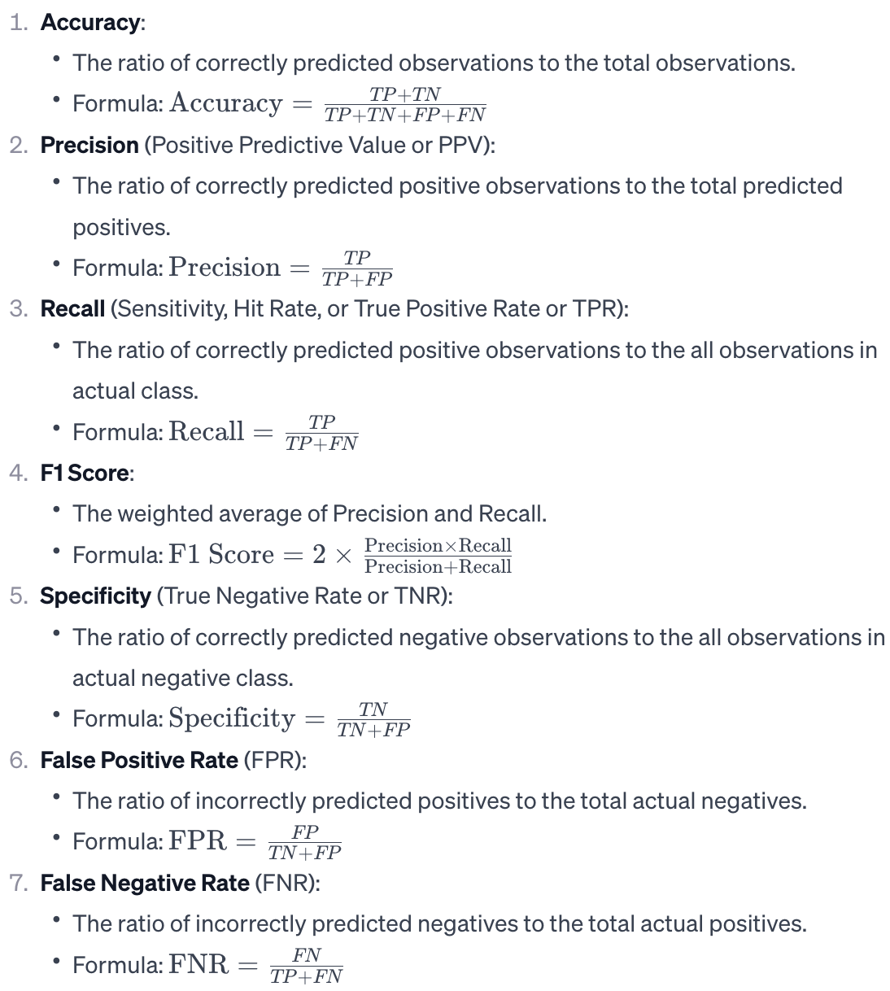
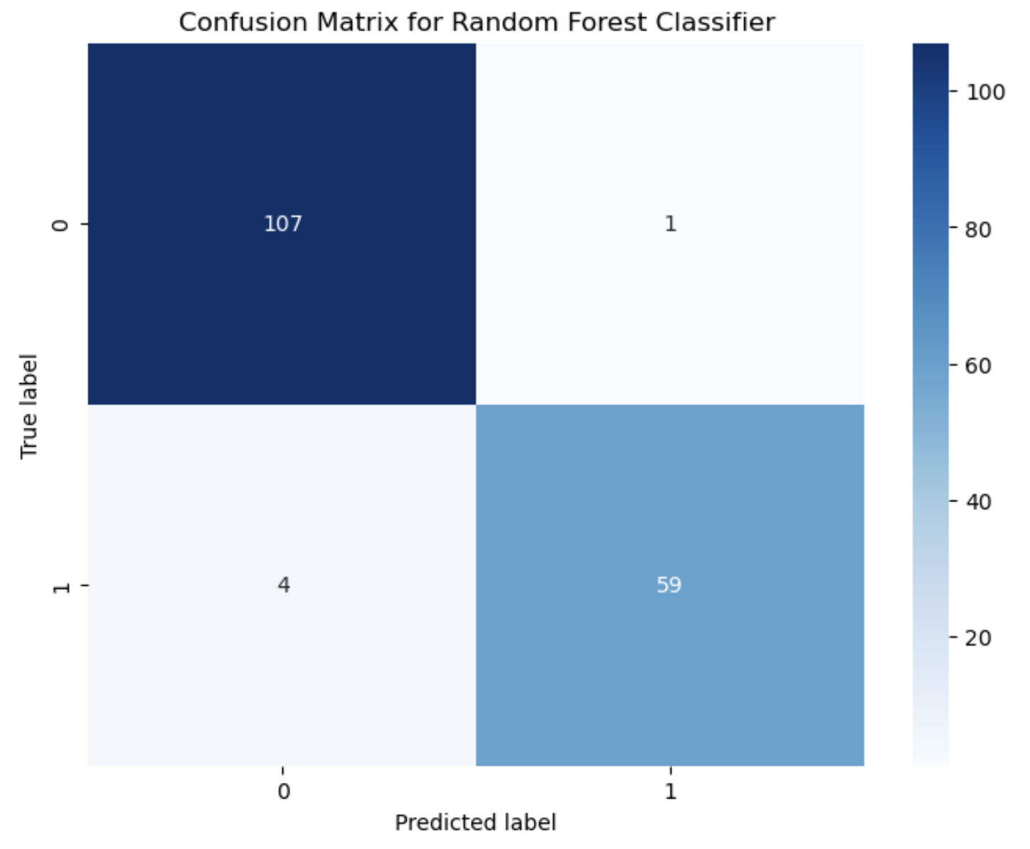
Confusion Matrix

Slide 21
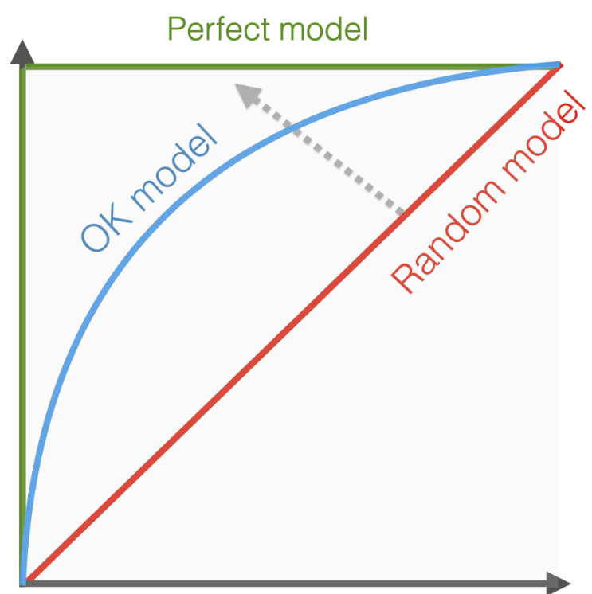
Receiver Operating Characteristic (ROC) Curve and ROC Area Under Curve(AUC) Score
Ideally, we need higher recall and lower False Positive Rate
Trade-off: when recall goes up(as we decrease threshold), so does False Positive Rate
Examples: credit card fraud detection(vacation), breast cancer
Random Model (AUC ~ 0.5): Performance similar to random guessing.
Acceptable Model (AUC ~ 0.8): Improved performance, targeting a specific AUC of 0.8.
Great Model (AUC ~ 0.9): High-performing model with a very good AUC.
Perfect Model (AUC = 1.0): Ideal model with perfect classification.
Sensitivity Recall, True Positive Rate
False Positive Rate
Copyright: Evidently AI

